Slide 1
GUI-RITS
Unzip GUI-RITS.zip by using proper password, then install with GUI-RITS.msi.
You can get the password by e-mail us.
(currently, kenichi.oikawa@j-parc.jp)

Slide 2
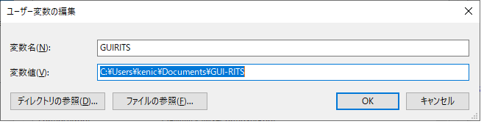

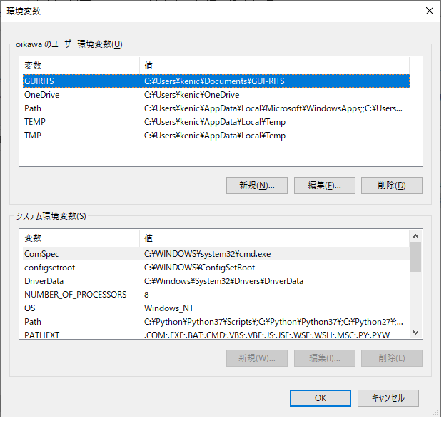
GUI-RITS ver1.5.0
First of all, Set environment variables in Windows.
In the search section of the menu bar at the bottom left of the screen, type "environment variables" and you will see "edit environment variables" in the search results (the one that is not a system environment variable).
There, create a user variable as shown in the figure on the right.
Note that the 'kenic' part is the login user name of each PC.
Then, close the environment variables window and double click the GUI-RITS.msi.
②
①
③

Slide 3
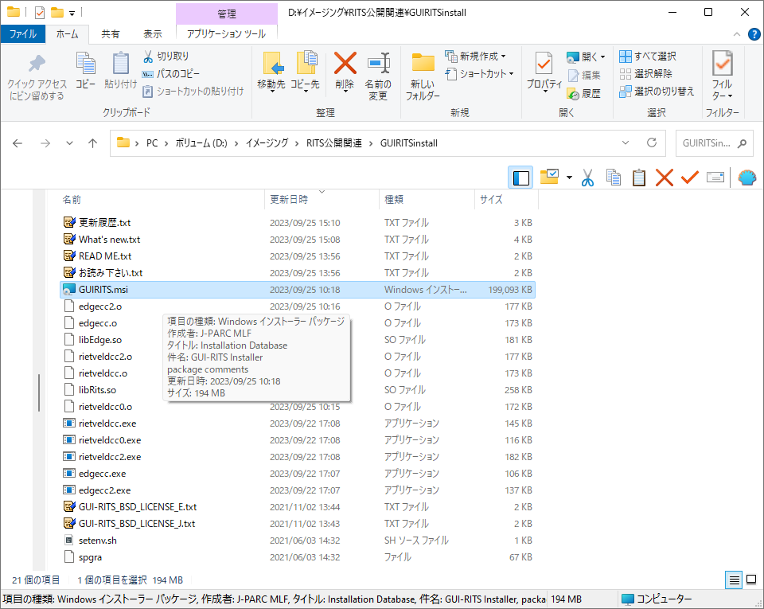
GUI-RITS ver1.5.0
Unzip GUI-RITS.zip by using proper password, then install with GUI-RITS.msi.
You can get the password by e-mail us.
(currently, kenichi.oikawa@j-parc.jp)

Slide 4
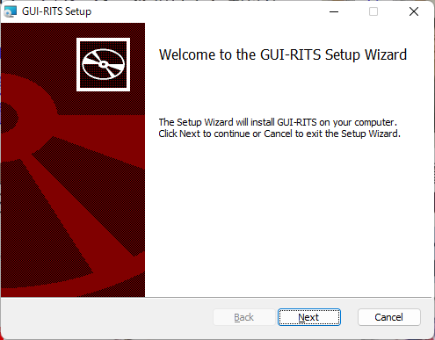
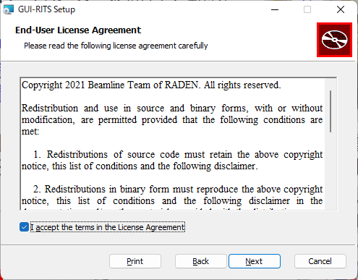
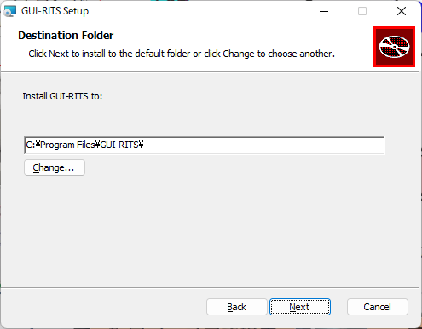
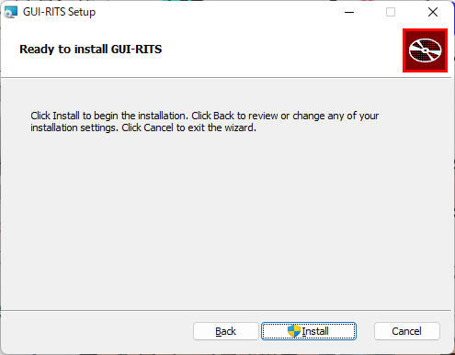
①
②
③
④
⑤

Slide 5
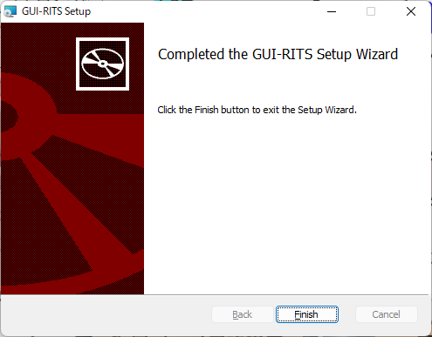
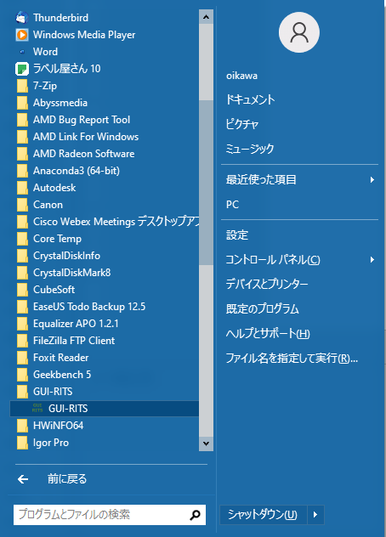
You will probably get “Do you want to allow apps from this unknown publisher to make changes to your device?”
Click “Yes”.
⑥
Launch the installed "GUI-RITS" from the application menu.
If the "terminal" and "main screen" as shown in the next page start, the installation is successful.

Slide 6
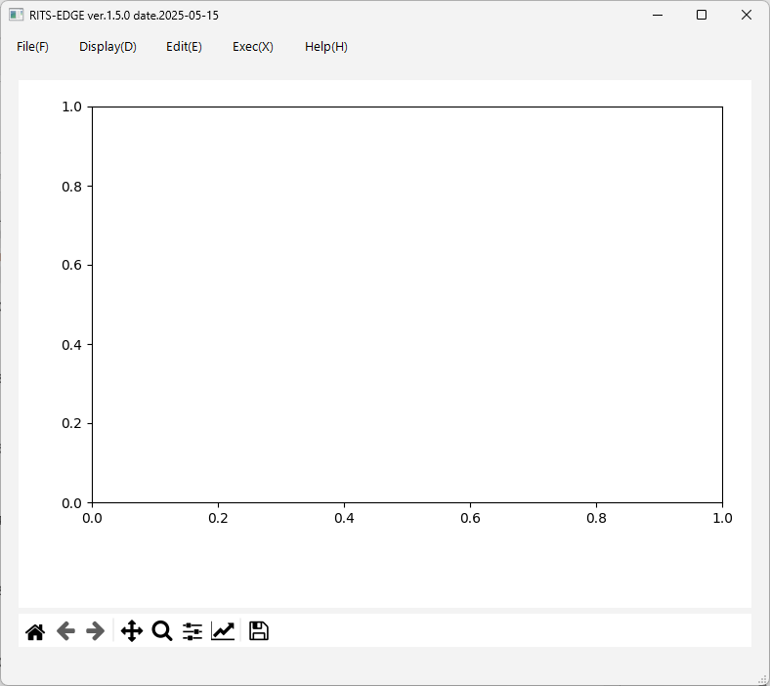
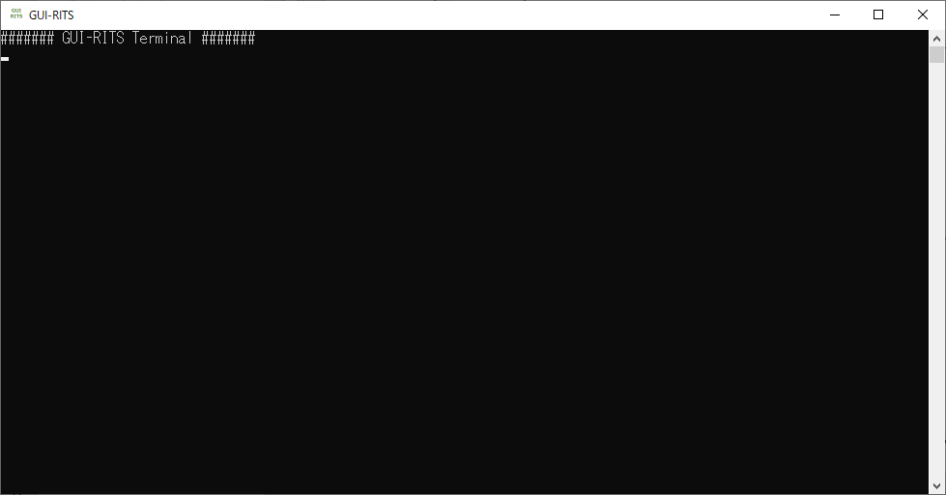
When you start GUI-RITS on Windows, two windows like this will be launched unless you customize it in any particular way.
Here, the lower left is called the "terminal" and the upper right is called the "main screen".
The terminal does not have any control functions. If it is in your way, you can hide it.
main screen
terminal

Slide 7
GUI-RITS
EDGE
RITS
RITS Simulation
Analysis of one data
Analysis of one data
Spectrum creation based on initial input values
EDGE2
RITS2
Analysis of many data
Analysis of many data
Notes:
GUI-RITSのパッケージにはこれらのプログラムが含まれています。
シングルエッジフィットを行うEDGEプログラム、フルパターンフィットを行うRITSプログラム、
これらを多数のスペクトルに対して行うEDGE2及びRITS2プログラム、
また、本日の説明では割愛しますが、シミュレーションパターンを生成するRITSシミュレーションです。

Slide 8
Points to note 1
When you try to "Load Data File“ after installing GUI-RITS, it does not load the data (it does not throw any error).
It doesn't work if there is a Japanese directory (i.e. double-byte characters) in the data loading path.
If we try to fix this, the source code will be different for each OS, so we'll leave it as is for now.

Slide 9
Points to note 2
When you try to run GUI-RITS after installing it for the first time, you might get an error message like "Cannot continue code execution because VCOMP140.DLL is missing.
The reason for this is that the above is not included in your windows.
You can get the VCOMP140.DLL by download
https://aka.ms/vs/17/release/vc_redist.x64.exe
and install it.

